Slide 1

Introduction to Operating Systems CS/COE 1550
Fall 2021
Sherif Khattab
ksm73@pitt.edu
(Some slides are from Silberschatz, Galvin and Gagne ©2013)

Slide 2
Announcements
Upcoming deadlines:
4/13: Quiz 3
4/14: Homework 11
4/21: Homework 12
4/23: Lab 5
4/26: Project 4 (File System)
5/2: Quiz 4
Tophat questions due one week after each lecture
OMETs
1 bonus point when response rate >= 80%

Slide 3
Last Lecture …
File System Implementation
Optimizing reliability
ECC
Spare sectors
RAID
Backup
Consistency Check
Sector Skew
Optimizing performance
file block cache

Slide 4
Muddiest Points (1/3)
Project 4
some tips for starting proj4, kinda lost on getting it started
More about implementing Project 4 functions
Hw 11
questions 2 and 3
8,9,10,11
Lab 5
are we supposed to add a new if statement in lab 5 or just modify the if(bn < nindirect) statement? The psuedocode says to modify it but I got a different response on piazza
Quiz 3.
3.1 and 3.3.

Slide 5
Muddiest Points (2/3)
What can cause a disk to go bad? Is it mostly user error or can other events cause them to go bad?
Once a disk sector fails, is it impossible to restore it?
if one file or directory is owned by A and it is copied to B, what's the difference C copied it under B and C copied it under A? and what will happen if somebody unlink it? do they all have revoke access?
what is disk sector
What is the difference between a sector and a partition?
2d parity
Another run through of how the Error Correction Code works.
what exactly is the point of sector skew
I could use another run through of the benefits of skewing and how it works
Disk Block Cache
Could we go over the linked list- looking graph for how the files are connected? It was a bit confusing to me
In the file block cache, why were certain blocks pointing to other blocks in the queue that were not adjacent?

Slide 6
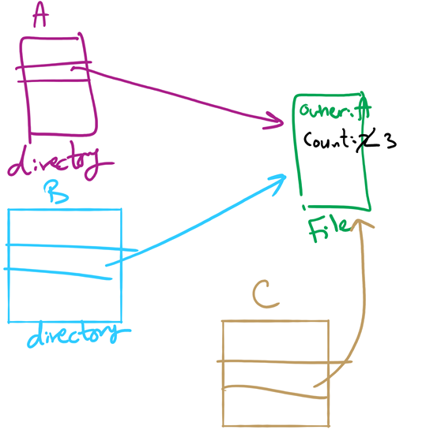
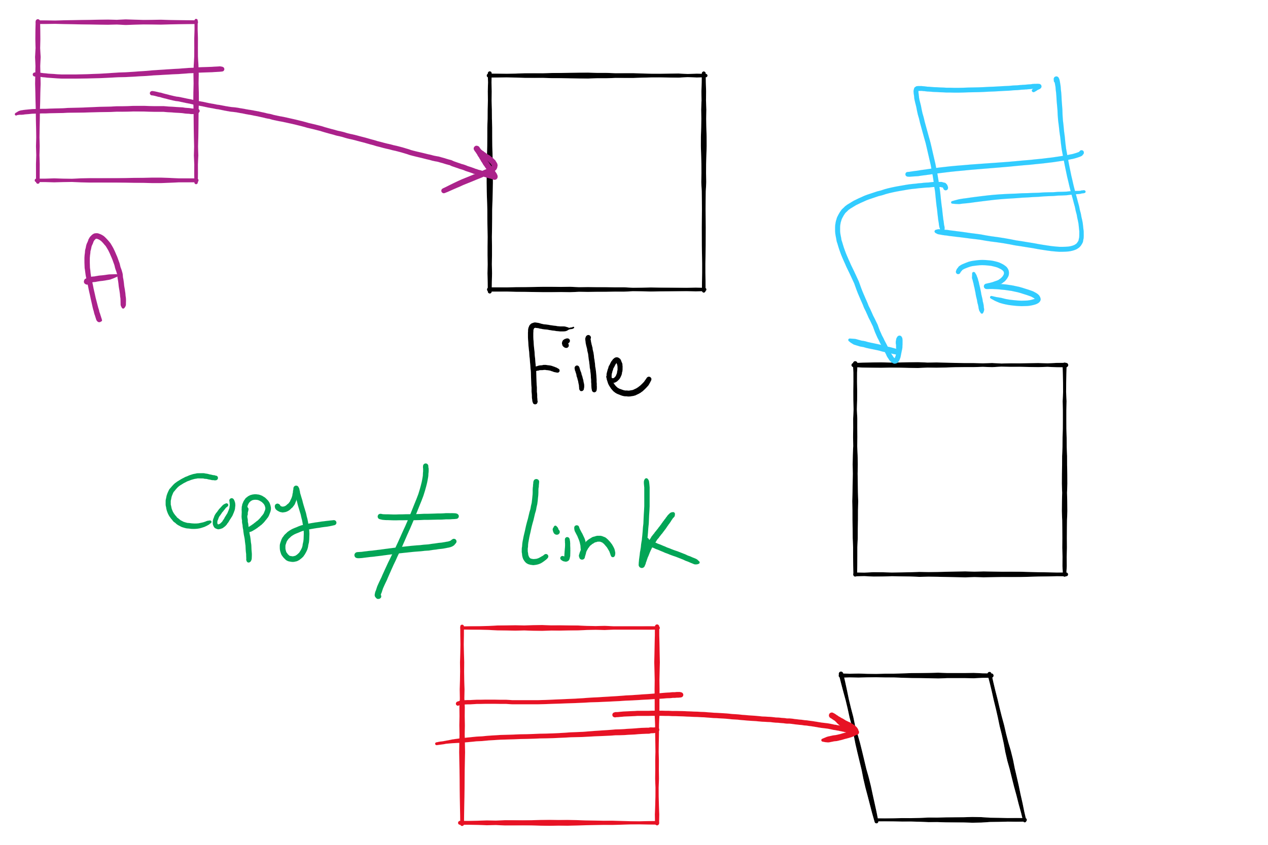
File Linking (left) vs. File Copying (right)

Slide 7
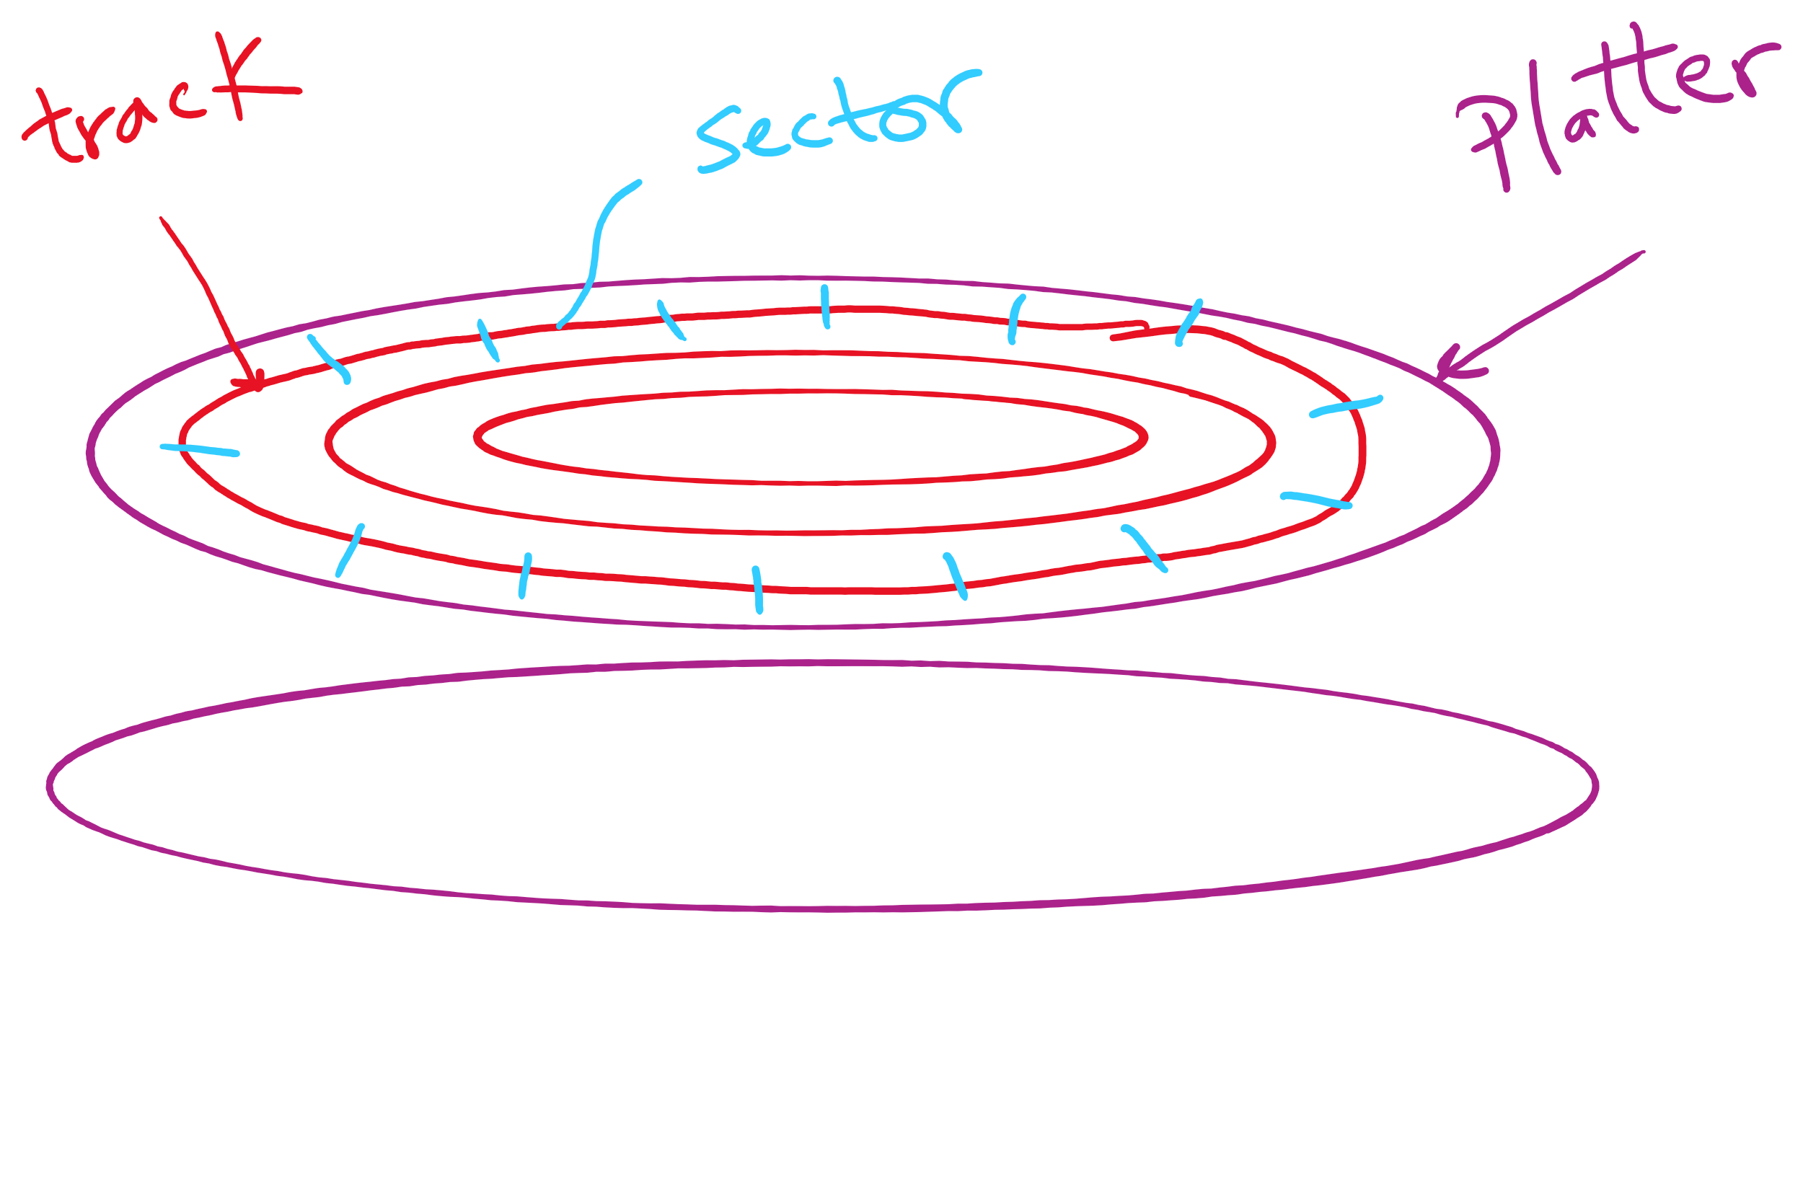
Disk Sector

Slide 8
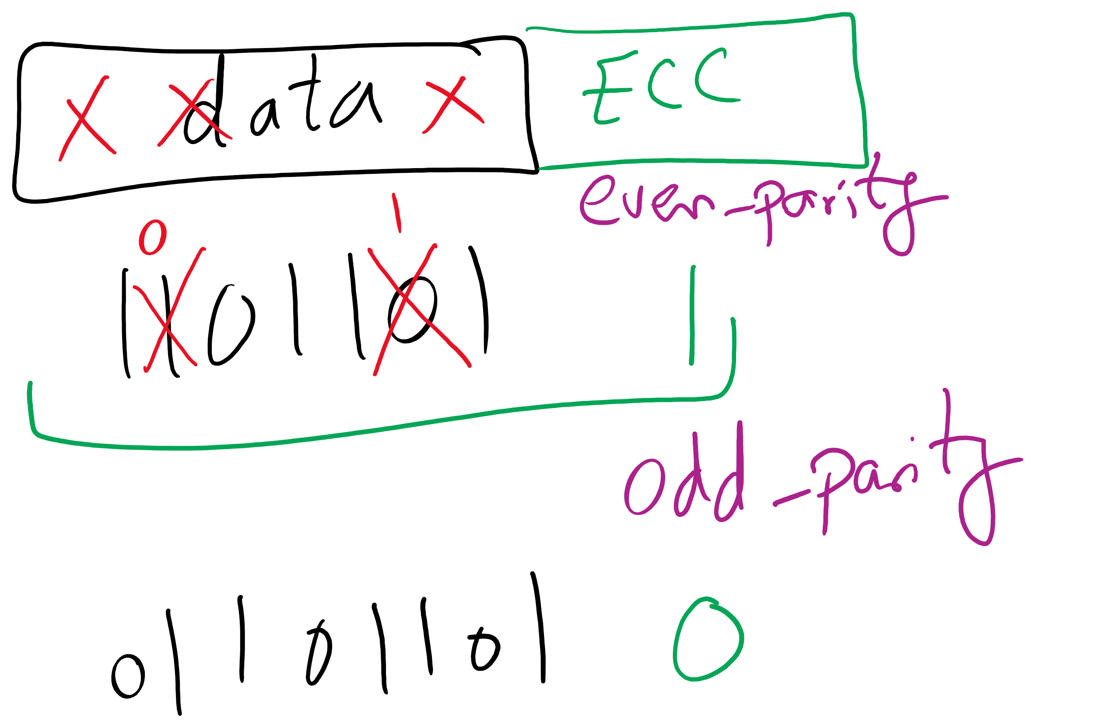
1-d parity

Slide 9
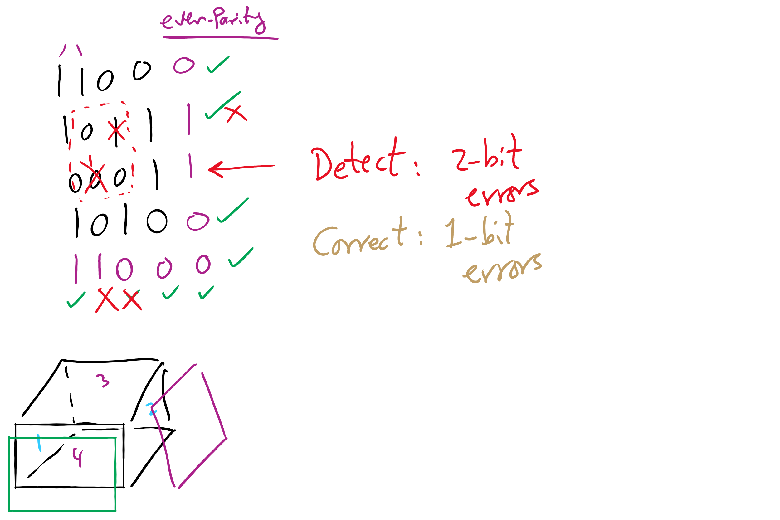
2-d parity

Slide 10
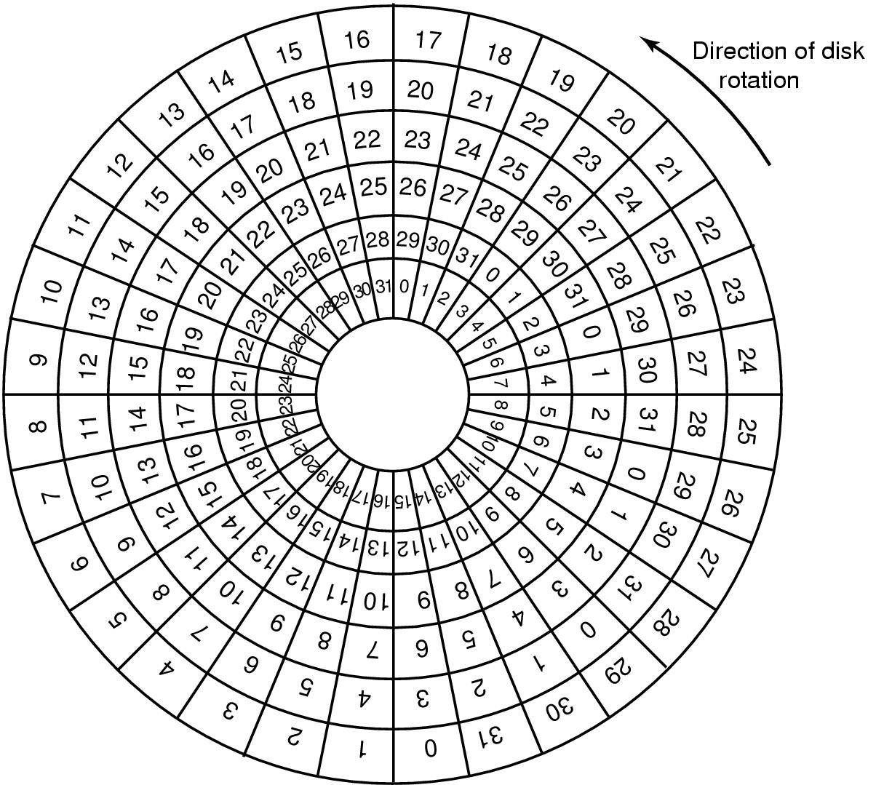
Sector Skew
Sectors numbered sequentially on each track
Numbering starts in different place on each track: sector skew
Allows time for switching head from track to track
All done to minimize delay in sequential transfers

Slide 11
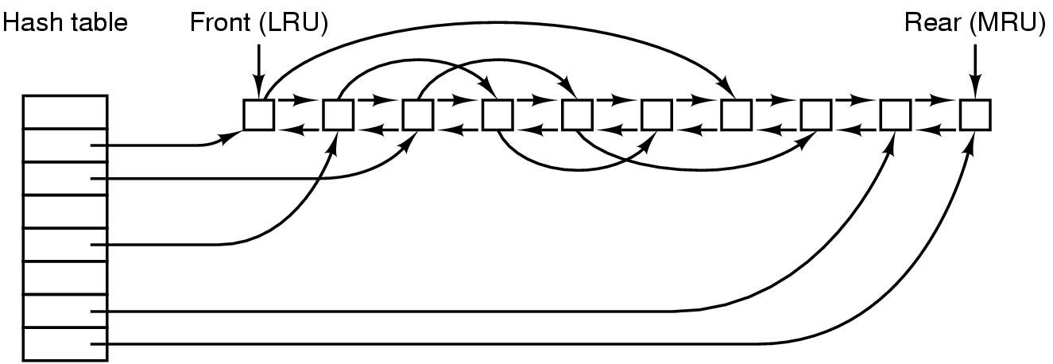
File block cache data structures

Slide 12
Muddiest Points (3/3)
RAID
RAID 4 and 5
the different RAID levels
Can you elaborate on the disk failures needed for data to be lost in RAID 4
from lecture 21, calculating the size of a block
File system backups
using bitmaps to back up files
If an i-node has all the block numbers of a file, do you still need to traverse a file such as by iterating through the blocks' pointers in order to find data, or is that only for allocating new blocks?
What happens when a disk runs out of spare sectors? Is that the total disk failure?
Overarching Questions
How does the OS manage different techniques for disk quality
An overview of each concepts purpose that we went over today would be nice (RAID, sector skew, etc.)

Slide 13
RAIDs, RAIDs, and more RAIDs
Stripe
strip
strip
RAID 0
(Redundant Array of Inexpensive Disks
RAID 1
(Mirrored copies)
RAID 4
(Striped with parity)
RAID 5
(Parity rotates through disks)

Slide 14
Today’s Agenda …
File System Implementation
Optimizing performance
Low-level device driver issues

Slide 15
Sector interleaving
On older systems, the CPU was slow => time elapsed between reading consecutive sectors
Solution: leave space between consecutively numbered sectors
This isn’t done much these days…
7
0
7
0
5
0
6
1
3
4
2
3
5
2
6
1
7
6
4
3
2
5
4
1
No interleaving
Skipping 1 sector
Skipping 2 sectors

Slide 16
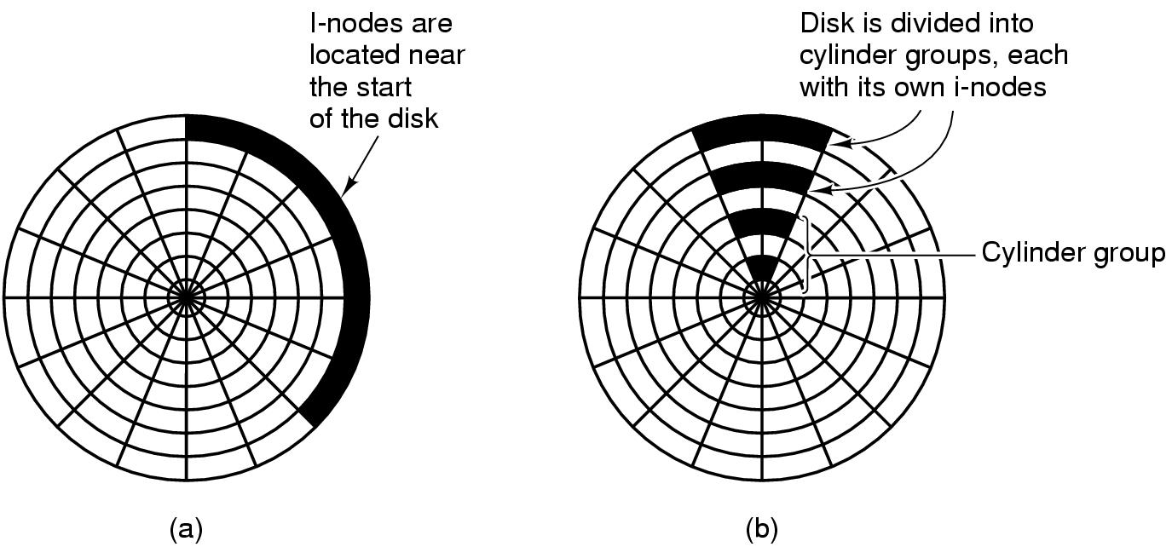
Grouping data on disk

Slide 17
Log-structured file systems
Trends in disk & memory
Faster CPUs
Larger memories
Result
More memory -> disk caches can also be larger
Increasing number of read requests can come from cache
Thus, most disk accesses will be writes
LFS structures entire disk as a log
All writes initially buffered in memory
Periodically write these to the end of the disk log
When file opened, locate i-node, then find blocks
Issue: what happens when blocks are deleted?

Slide 18
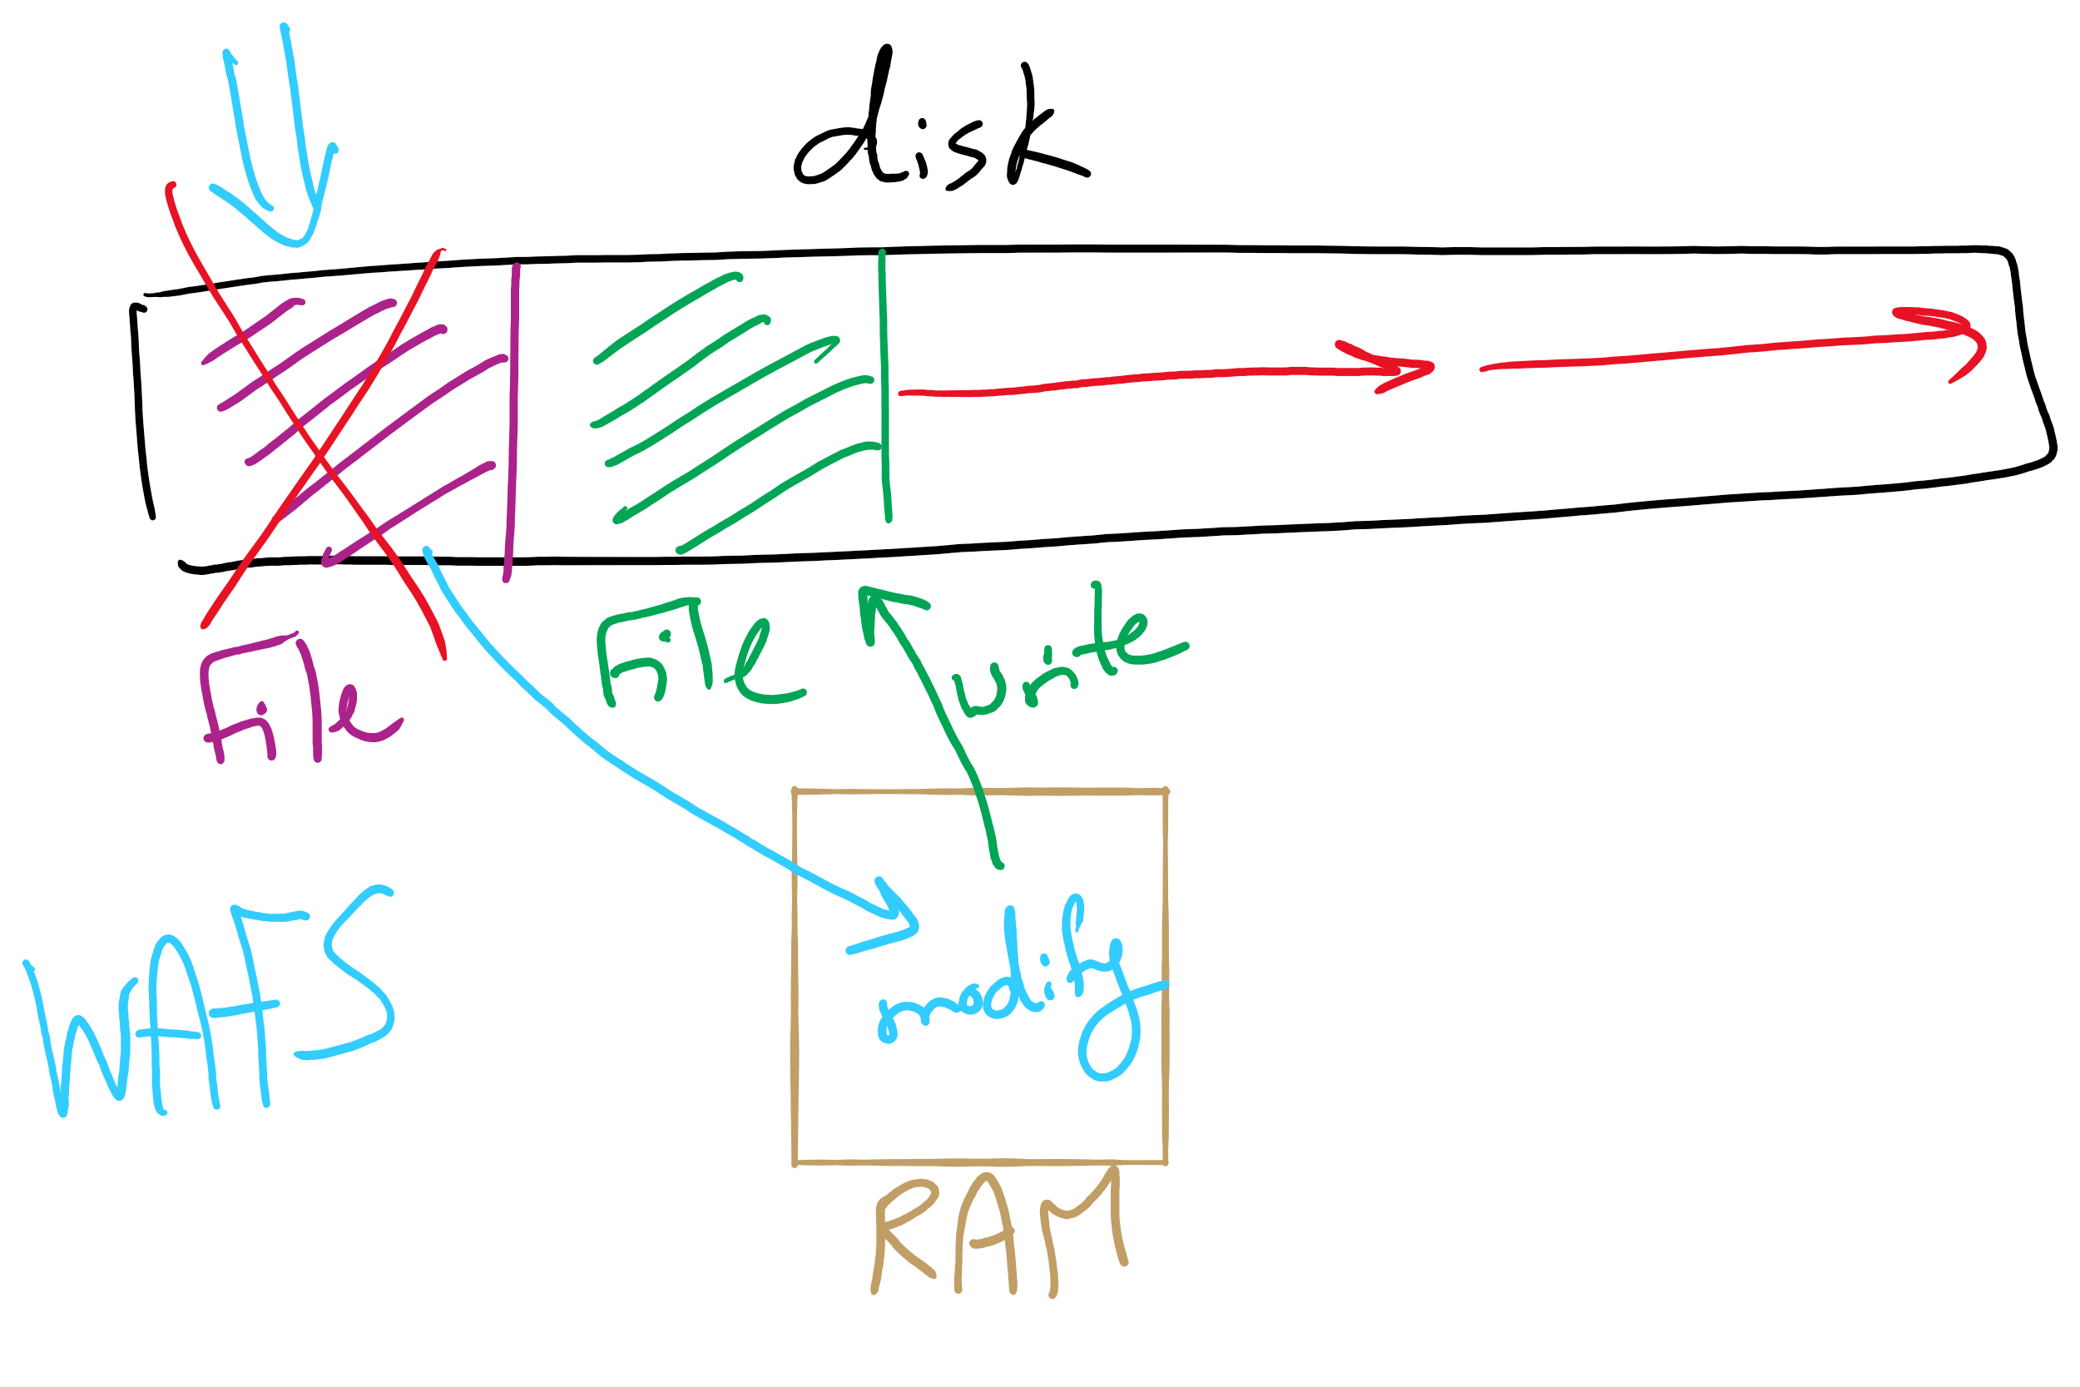
Log Structured File System

Slide 19
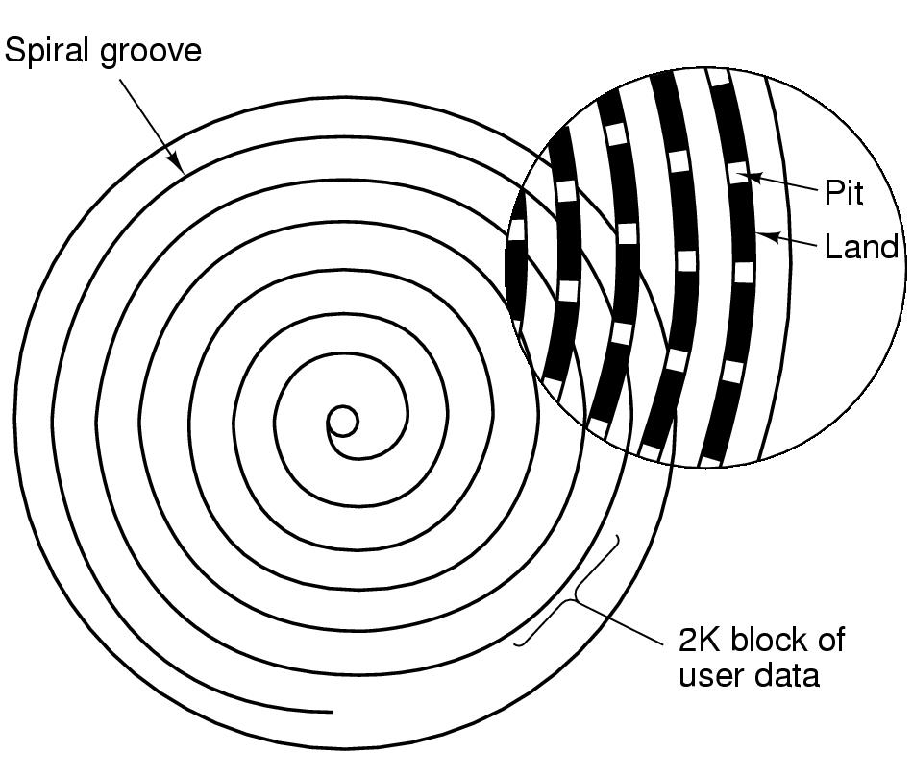
CD-ROM recording
CD-ROM has data in a spiral
Hard drives have concentric circles of data
One continuous track: just like vinyl records!
Pits & lands “simulated” with heat-sensitive material on CD-Rs and CD-RWs

Slide 20
Flash File System
Wear Leveling
Count total writes per flash sector and attempt to balance across the whole disk

